Slide 1
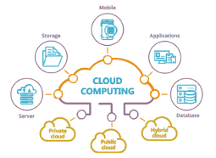


Slide 2
Design Patterns
A generally reusable solution to a recurring problem
■  
A template to solve the problem
Best practices in approaching the problem Improve developer communication

Slide 3
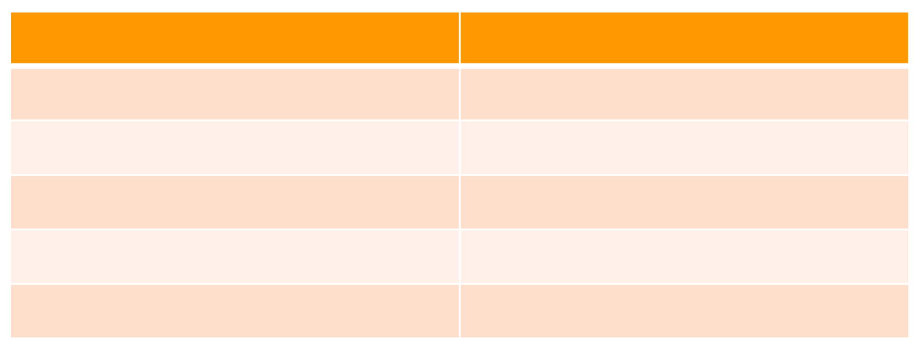
Cloud Application Development Issues
Availability
The guaranteed proportion of time that the system is functional
SLA – Service Level Agreement
Availability (%)
Downtime per year
99
3.7 days
99.9
9 hours
99.95
4.4 hours
99.99
1 hour
99.999
5 minutes

Slide 4
Cloud Application Development Issues
Data Management
■
Typically hosted in different locations and across multiple servers for performance, scalability and availability
■
Maintaining consistency and synchronizing
Design and Implementation
■  
Consistent and coherent component design Improves ease of deployment and maintenance Reusability of components

Slide 5
Cloud Application Development Issues
❐
Messaging
■
Messaging infrastructure to connect distributed components and services
■
Asynchronous messaging
❐
Design and Implementation
■  
Consistent and coherent component design Improves ease of deployment and maintenance Reusability of components

Slide 6
Cloud Application Development Issues
❐
Management and Monitoring
■
Cloud applications run in in a remote servers with limited control
Performance and Scalability
❐
■
Responsiveness of a system to execute any action within a given time interval
■
Handle increases in load without impact on performance
■
How to handle variable workloads?

Slide 7
Cloud Application Development Issues
❐
Resiliency
■
Ability of the application to gracefully handle and recover from failures
Applications are more prone to failure in cloud
■
environments
❐
Security
■
Prevent malicious or accidental actions outside of the designed usage
■
Prevent disclosure or loss of information

Slide 8
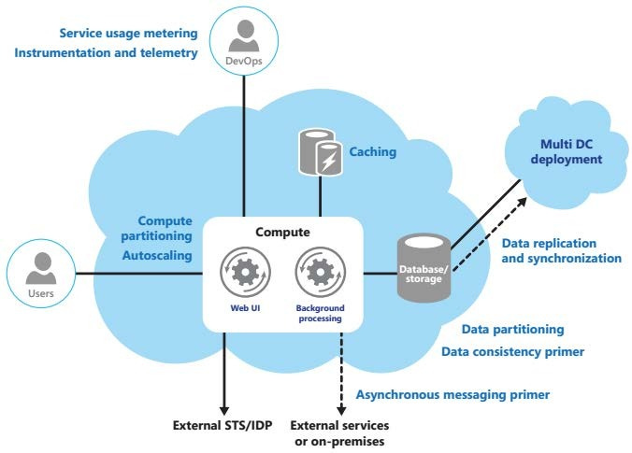
High-Level Model
STS – Security Token Service IDP – Identity Provider

Slide 9
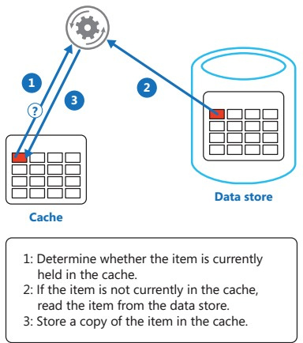
Cache-Aside Pattern
❐
Load on demand data into a cache from a data store
Pros
❐
Increased performance
Cons
❐
■
Maintaining consistency between data in cache & data in underlying data store
❐
Solutions
■   
Azure Cache AWS ElastiCache Google App Engine memcache Redis Cache

Slide 10
Cache-Aside Pattern (Cont.)
❐
When
■
Read/write performance
❐
Parameters
■    
What to cache
Lifetime of cached data Cache size
Evicting data In Memory Caching

Slide 11
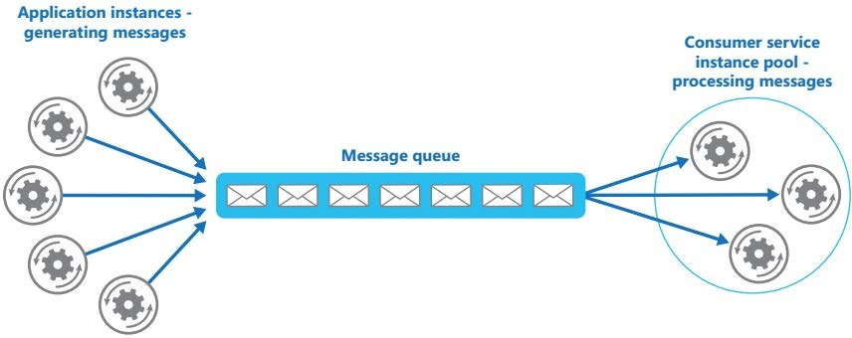
Competing Consumers Pattern
❐
Multiple concurrent consumers to process messages received on same channel
Goals
❐
■
Optimize throughput, improve scalability & availability, load balancing

Slide 12
Competing Consumers Pattern (Cont.)
❐
When
■  
Independent tasks that can be processed parallel Volume of work is highly variable
High availability

Slide 13
Competing Consumers Pattern (Cont.)
❐
Parameters
■      
Queue size
Scaling
Not loosing messages Preserving message ordering Resiliency
Poison/malformed messages
Returning results

Slide 14
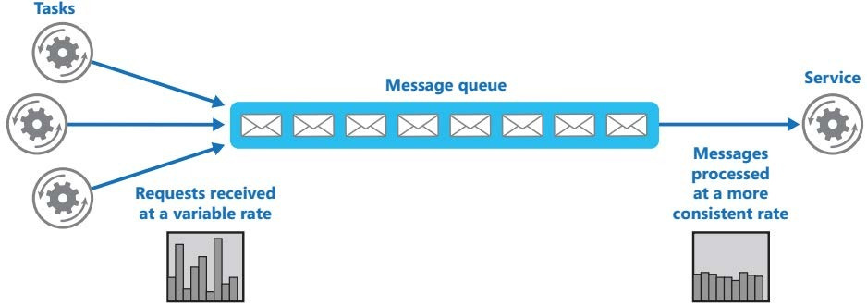
Queue-Based Load Leveling Pattern
❐
To smooth intermittent heavy loads that may otherwise cause the service to fail or the task to time out

Slide 15
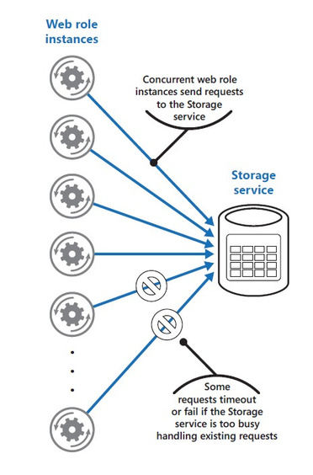
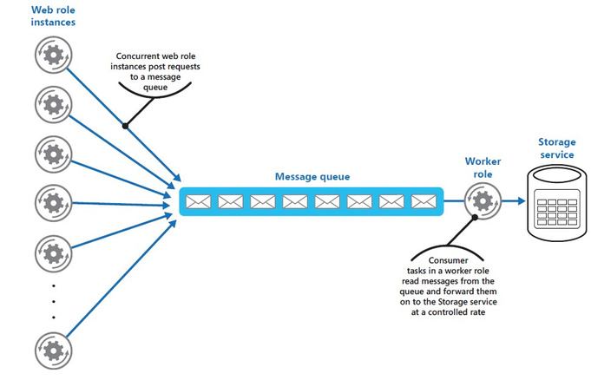
Queue-Based Load Leveling Pattern

Slide 16
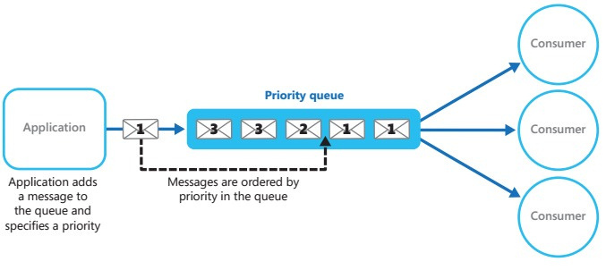
Priority Queue Pattern
❐
Prioritize requests sent to services so that requests with a higher priority are received & processed quickly

Slide 17
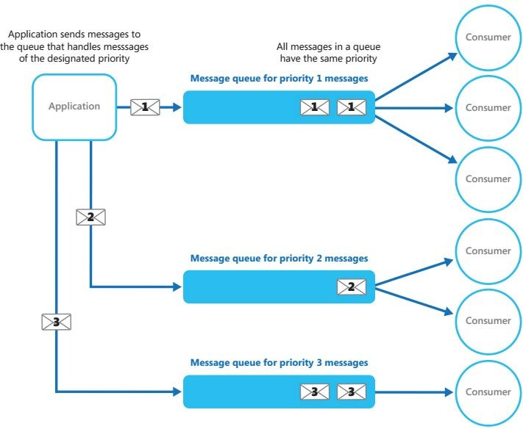
Priority Queue Pattern (Cont.)

Slide 18
Priority Queue Pattern (Cont.)
❐
When,
■
The system handles multiple tasks that have different priorities
■
Different users should be served with different
priorities

Slide 19
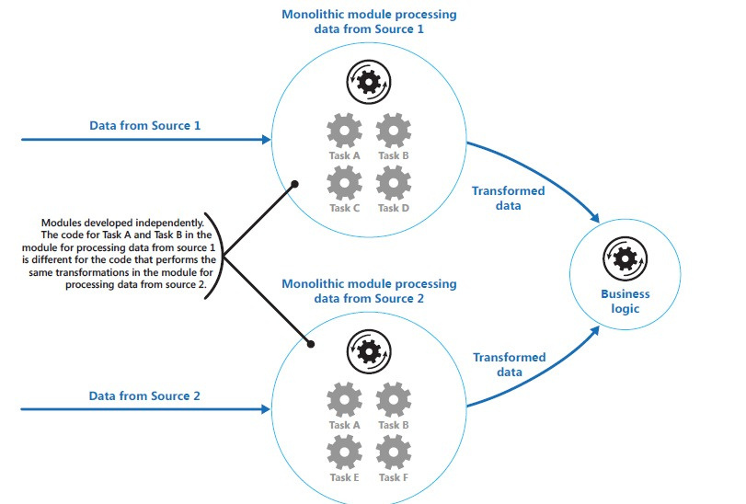
Pipes & Filters Pattern

Slide 20
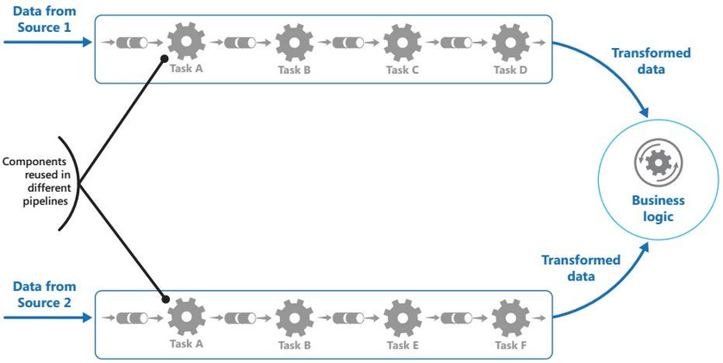
Pipes & Filters Pattern (Cont.)
❐
Decompose a task that performs complex processing into a series of discrete elements that can be reused

Slide 21
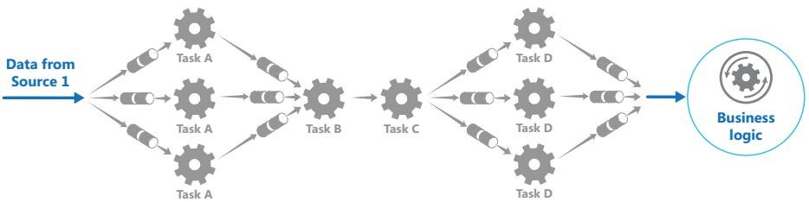
Pipes & Filters Pattern – With Load Balancing
When,
■   
Application can be decomposed to steps Steps have different scalability requirements Flexibility of processing
Need distributed processing

